Slide 1




superstore sales project
supervised by Eng. kareem Bakli

Slide 2

Introduction
Objective: to Build and create an interactive Power BI dashboard that analyze sales performance, identify trends, and improve decision-making

Slide 3




Tools used
01.
Excel
Microsoft Power Bi
02.
03.
Python (Pandas Library)

Slide 4


Content
d
Data Cleaning & Transformation
Data analysis &
Metrics creation
Dashboard & KPI’S
Report storytelling & interactivity
Reccomendation

Slide 5

2- Data cleaning & transformation
✅started with 7 original tables (Sales_Fact, Calendar, Dim_country, Dim_Customer, Dim_Product,Dim_Region,Dim_ship).
🧩 Handling missing values and duplicates correct errors, changing data type
📊 IN Python (Importing Pandas library) to:
identifying missing values, summarizing statistics, and visualizing key insights like sales distribution.
It concluded by saving the cleaned and analyzed data in CSV and Excel formats for future use.

Slide 6
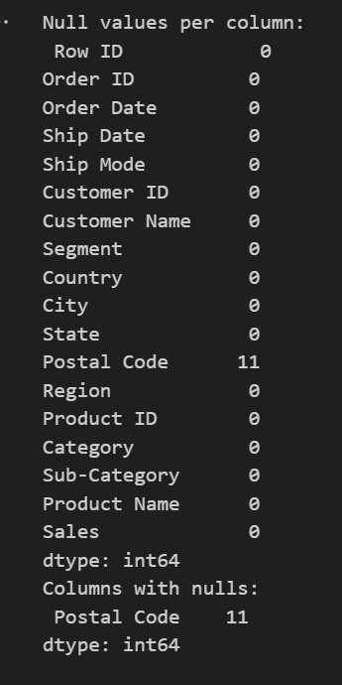
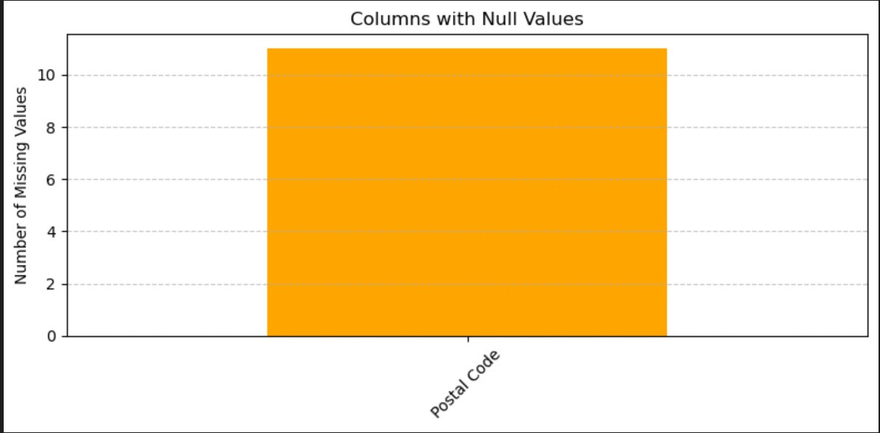
2- Data cleaning & transformation

Slide 7
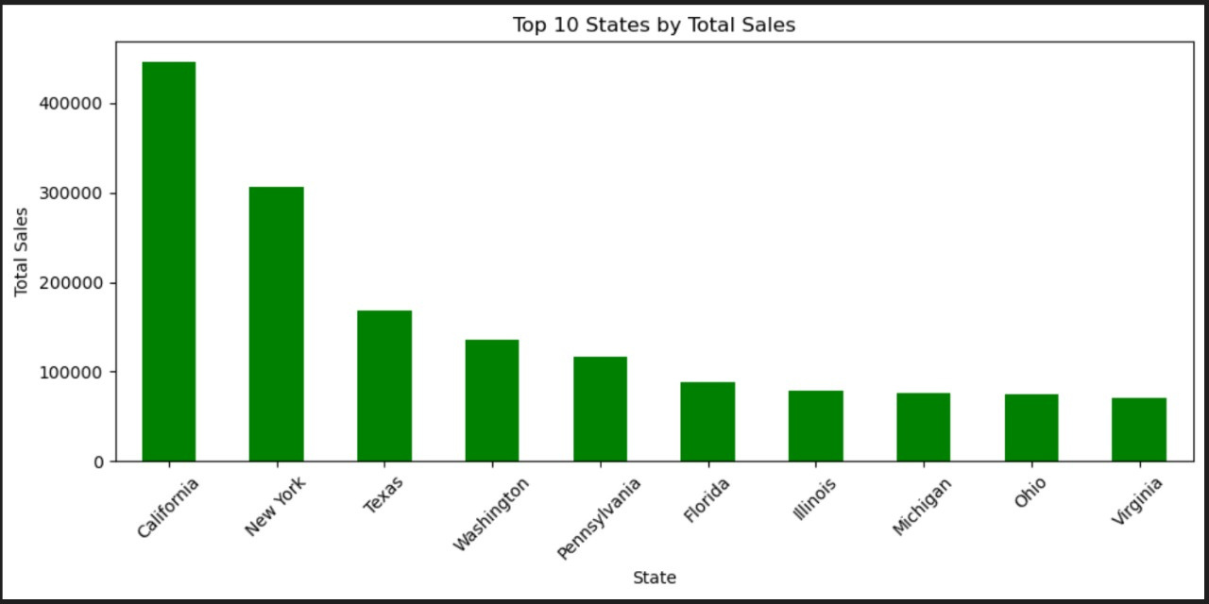
VIZ using Python

Slide 8
Content
Data cleaning and transformation
Data Analysis and Metrics Creation
Data analysis &
Metrics creation
Dashboard & KPI’S
Report storytelling & interactivity
recommendation

Slide 9
3-Data analysis and
Metrics creation
01.
02.
we defined relationship as it is a key to data modelling to connect tables
we used Dax to Calculate Total sales, Gross profit, Customer, regional and Shipping insights

Slide 10
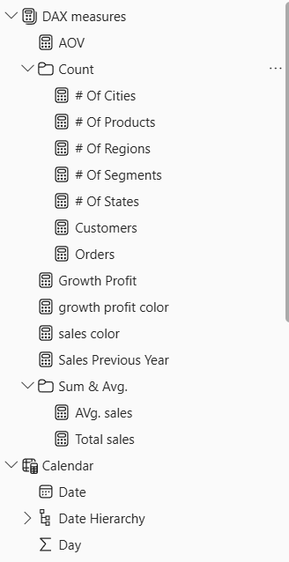
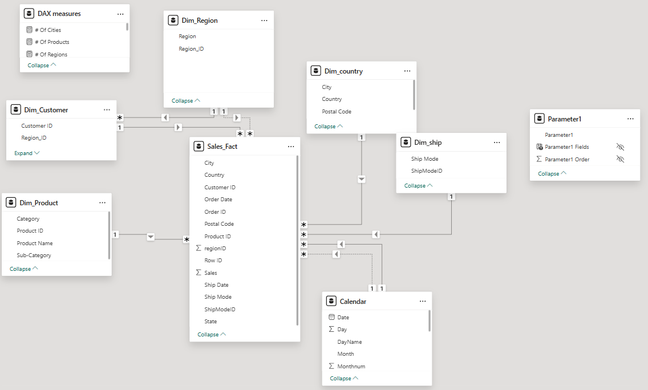
3-Data analysis and
Metrics creation

Slide 11
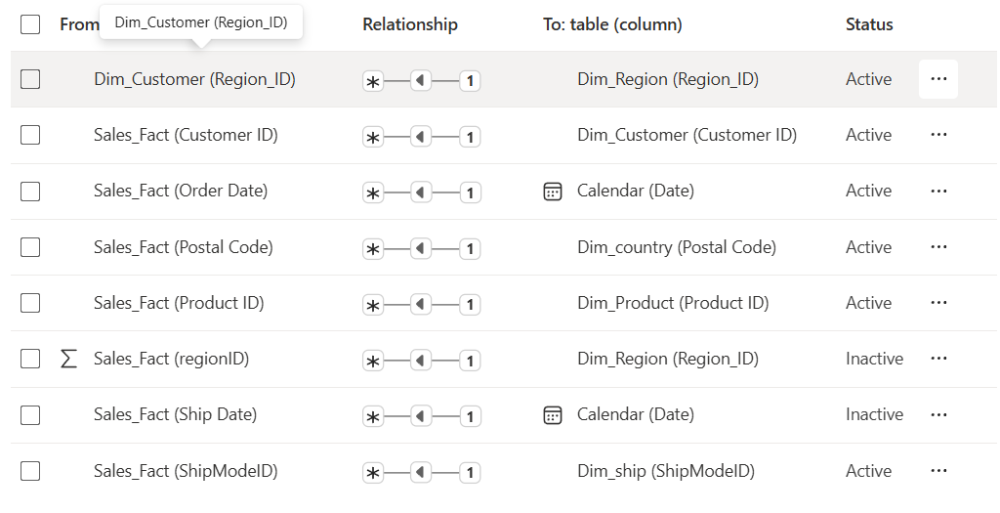
Data Modeling and Relationships

Slide 12
table and some attrubutes before
7 Tables
1 Fact 6 Dim_tables
Dim_country
Dim_ Region
Dim_ship
country
region
Sales_Fact
state
ship mode
region id
city
ship mode id
order id
Postal code
customer id
Dim_product
country
product id
Dim_customer
Dim_calender
product name
city
state
customer name
category
date
postal code
sub-category
segment
day
product id
customer id
month

Slide 13
Content
Data cleaning and transformation
Data analysis &
Metrics creation
Dashboard & KPI’S
Report storytelling & interactivity
recommendation

Slide 14
4-Dashboard & KPI’S
Goal: Make the dashboard informative and easy to use
What We Designed:
sorting layout with top-level KPIs
Filters to view data by Customer segment and Product Category.
Color-coded visuals for easy reading
Icons and charts to tell the story quickly

Slide 15
4-Dashboard & KPI’S
• KPIs shown:
Total Sales, Sales by category, Total customers, AVG Sales value, orders by ship mode, Sales by month, Month name, Sales by region,

Slide 16
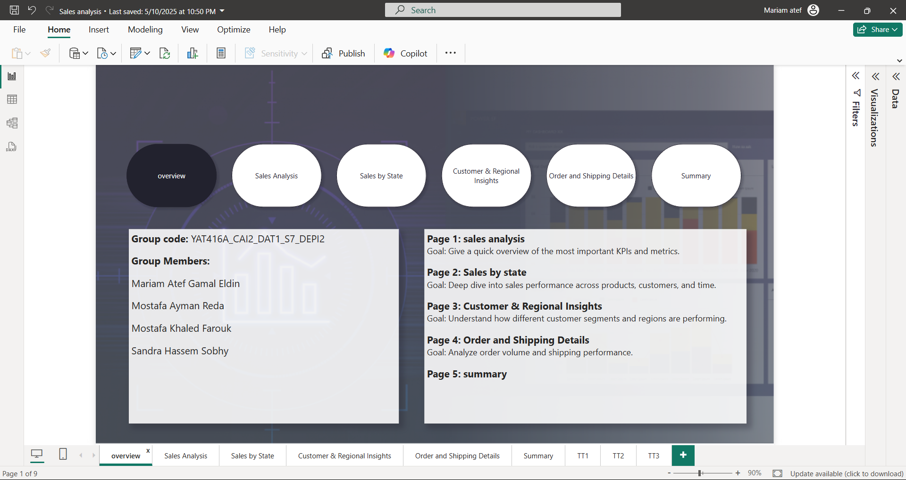
overview
This is a clean and professional introduction slide. listing group members and provides a clear overview of the report’s structure

Slide 17
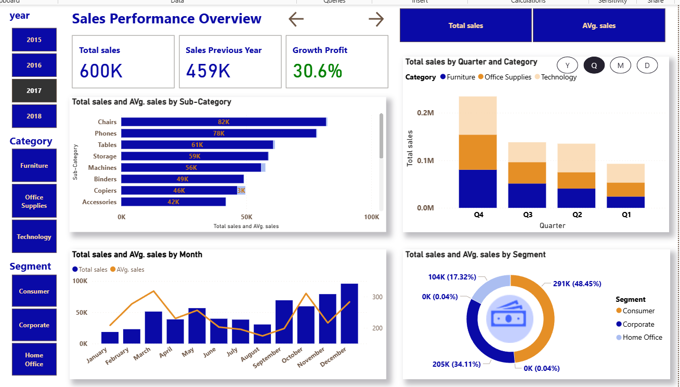
Sales Analysis & KPIs

Slide 18
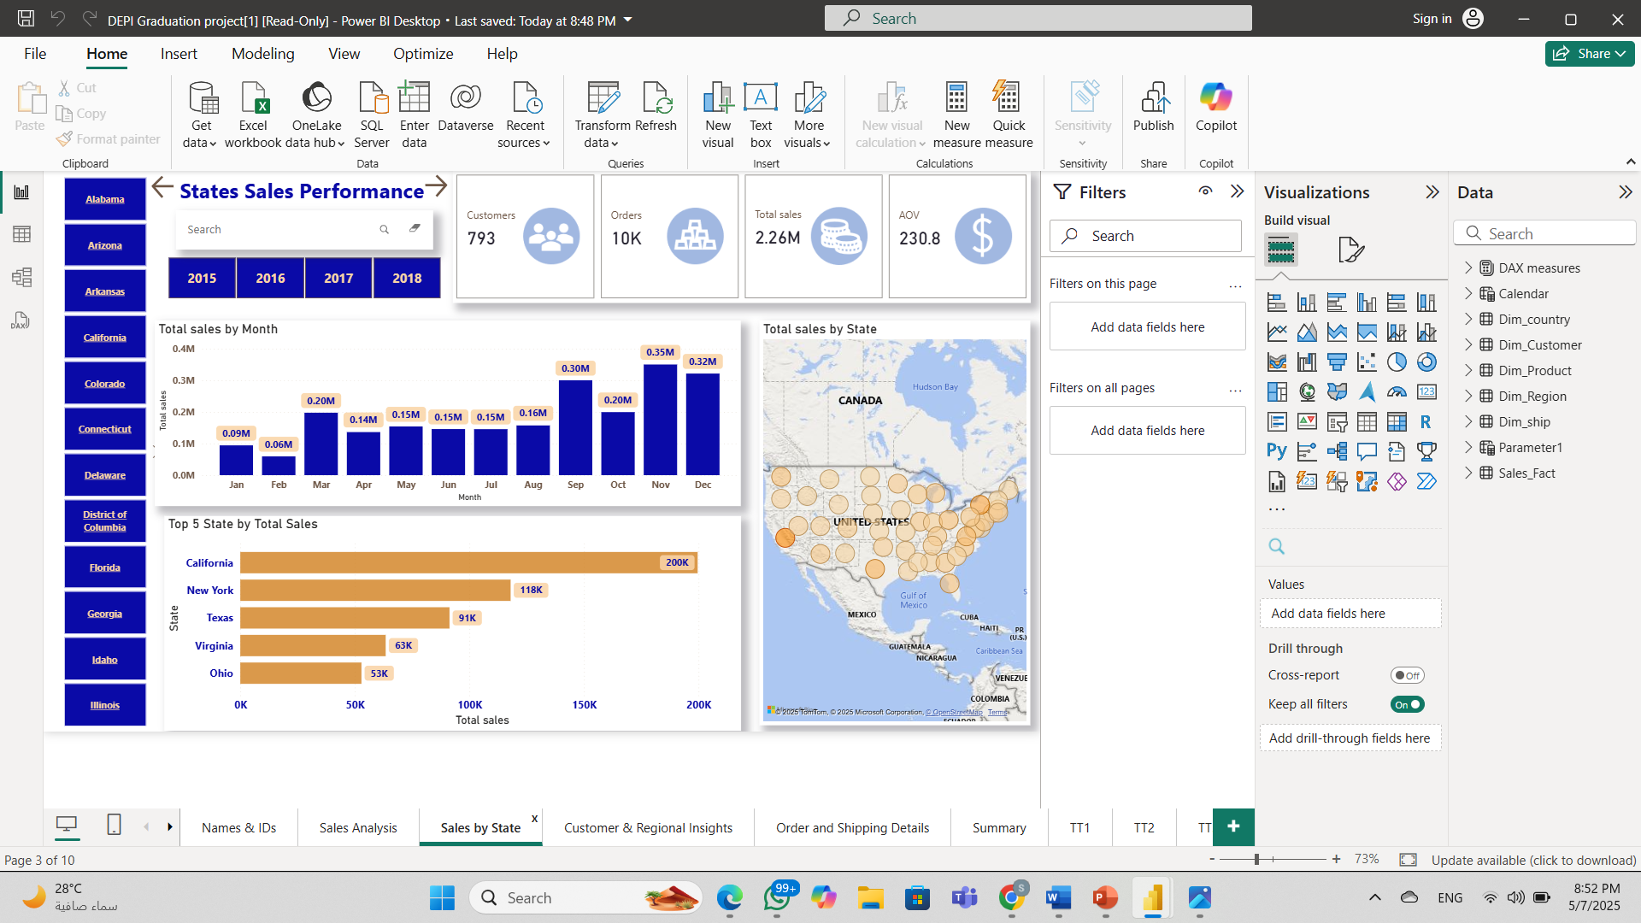
States Sales Performance

Slide 19
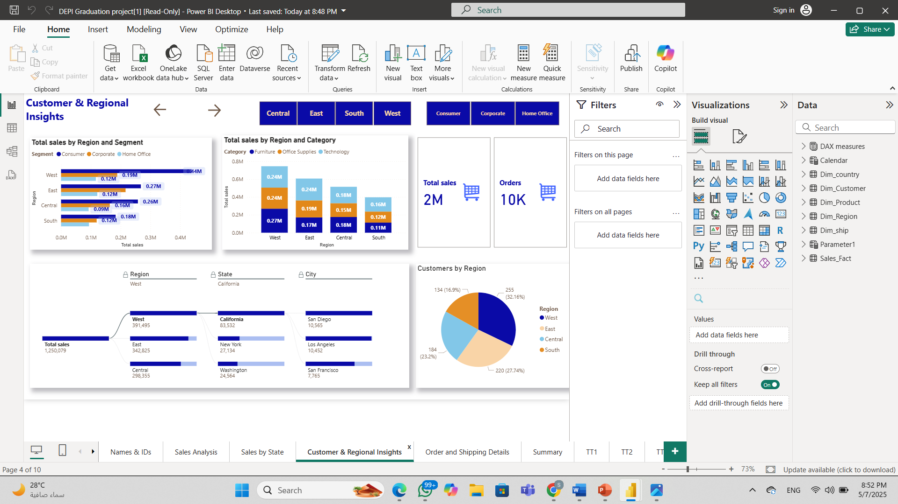
Customer & Regional Insights

Slide 20
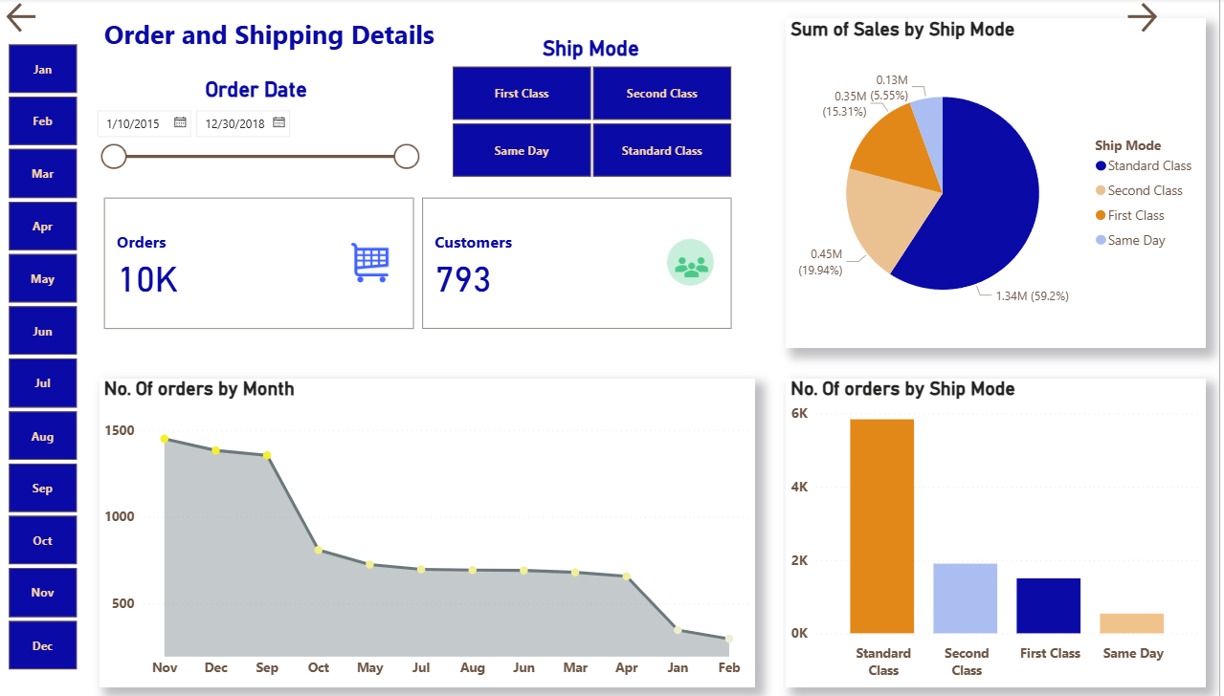
Customer & Regional Insights

Slide 21
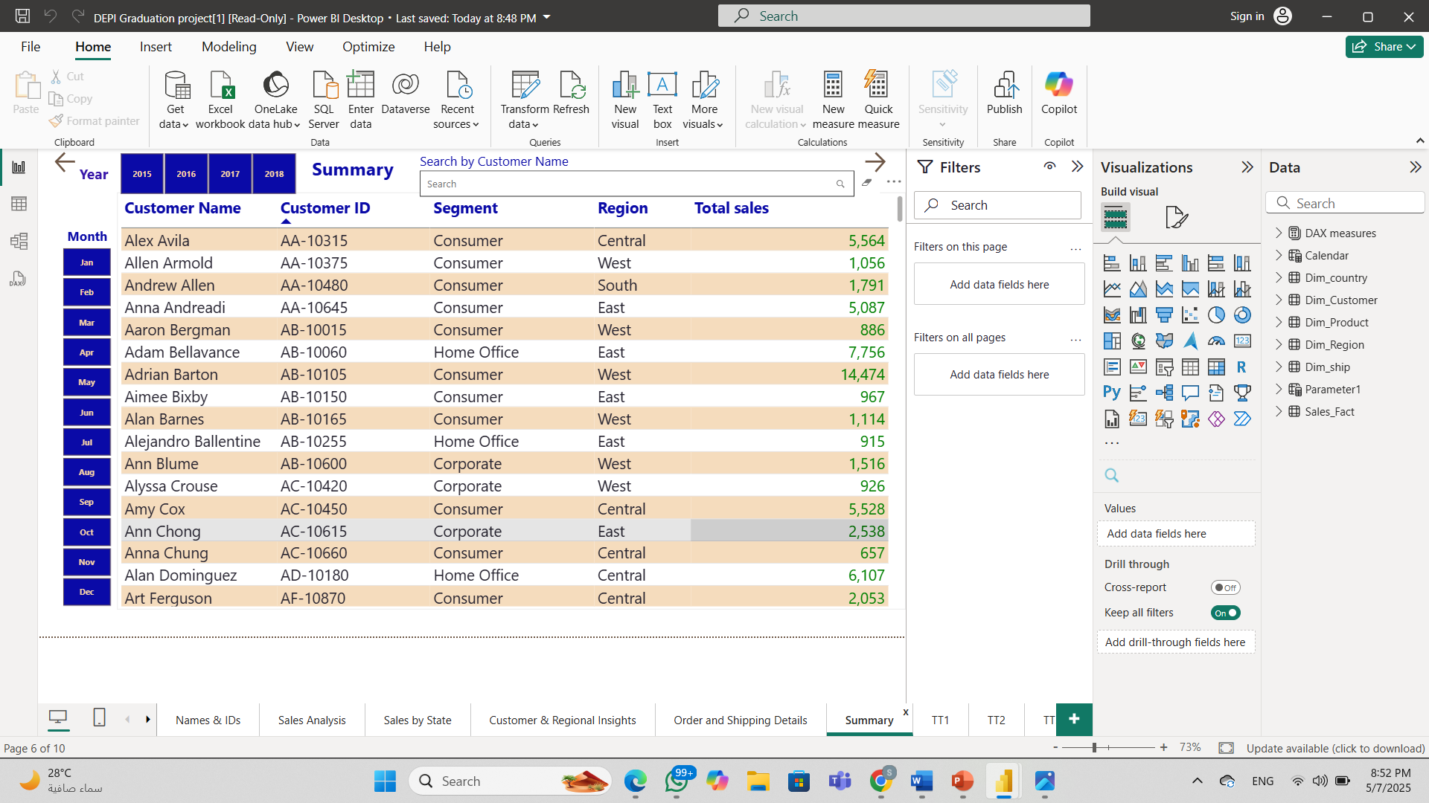
Summary

Slide 22
Content
Data cleaning and transformation
Data analysis &
Metrics creation
Dashboard &
KPI’S
Report storytelling & interactivity
recommendation

Slide 23

5- Report storytelling & interactivity
Storytelling:
Dashboard follows a clear flow: from overall sales metrics to category and region-specific insights.
Key KPIs like Total Sales, Profit, and Sales Growth are highlighted at the top.
Charts help explain patterns (e.g., sales by product category, regional performance over time, top customers).
interactivity:
Filters added for region, product category, customer segment, and more.
Slicers and dropdowns make it easy to explore sales data from different angles.
Tooltips show extra info like profit margins and order details on hover.
Drill-through pages let users dive into specific product or customer performance when needed.

Slide 24
Content
Data cleaning and transformation
Data analysis &
Metrics creation
Dashboard & KPI’S
Report storytelling & interactivity
Recommendation

Slide 25

6- Reccomendation
Summary of Priority Actions:
Boost sales in underperforming regions
Focus on high-gross profit product categories
Optimize inventory for best-selling items
Target marketing efforts by customer segment
Monitor sales trends to adjust pricing and promotions

Slide 26

Thank you !

